Slide 1
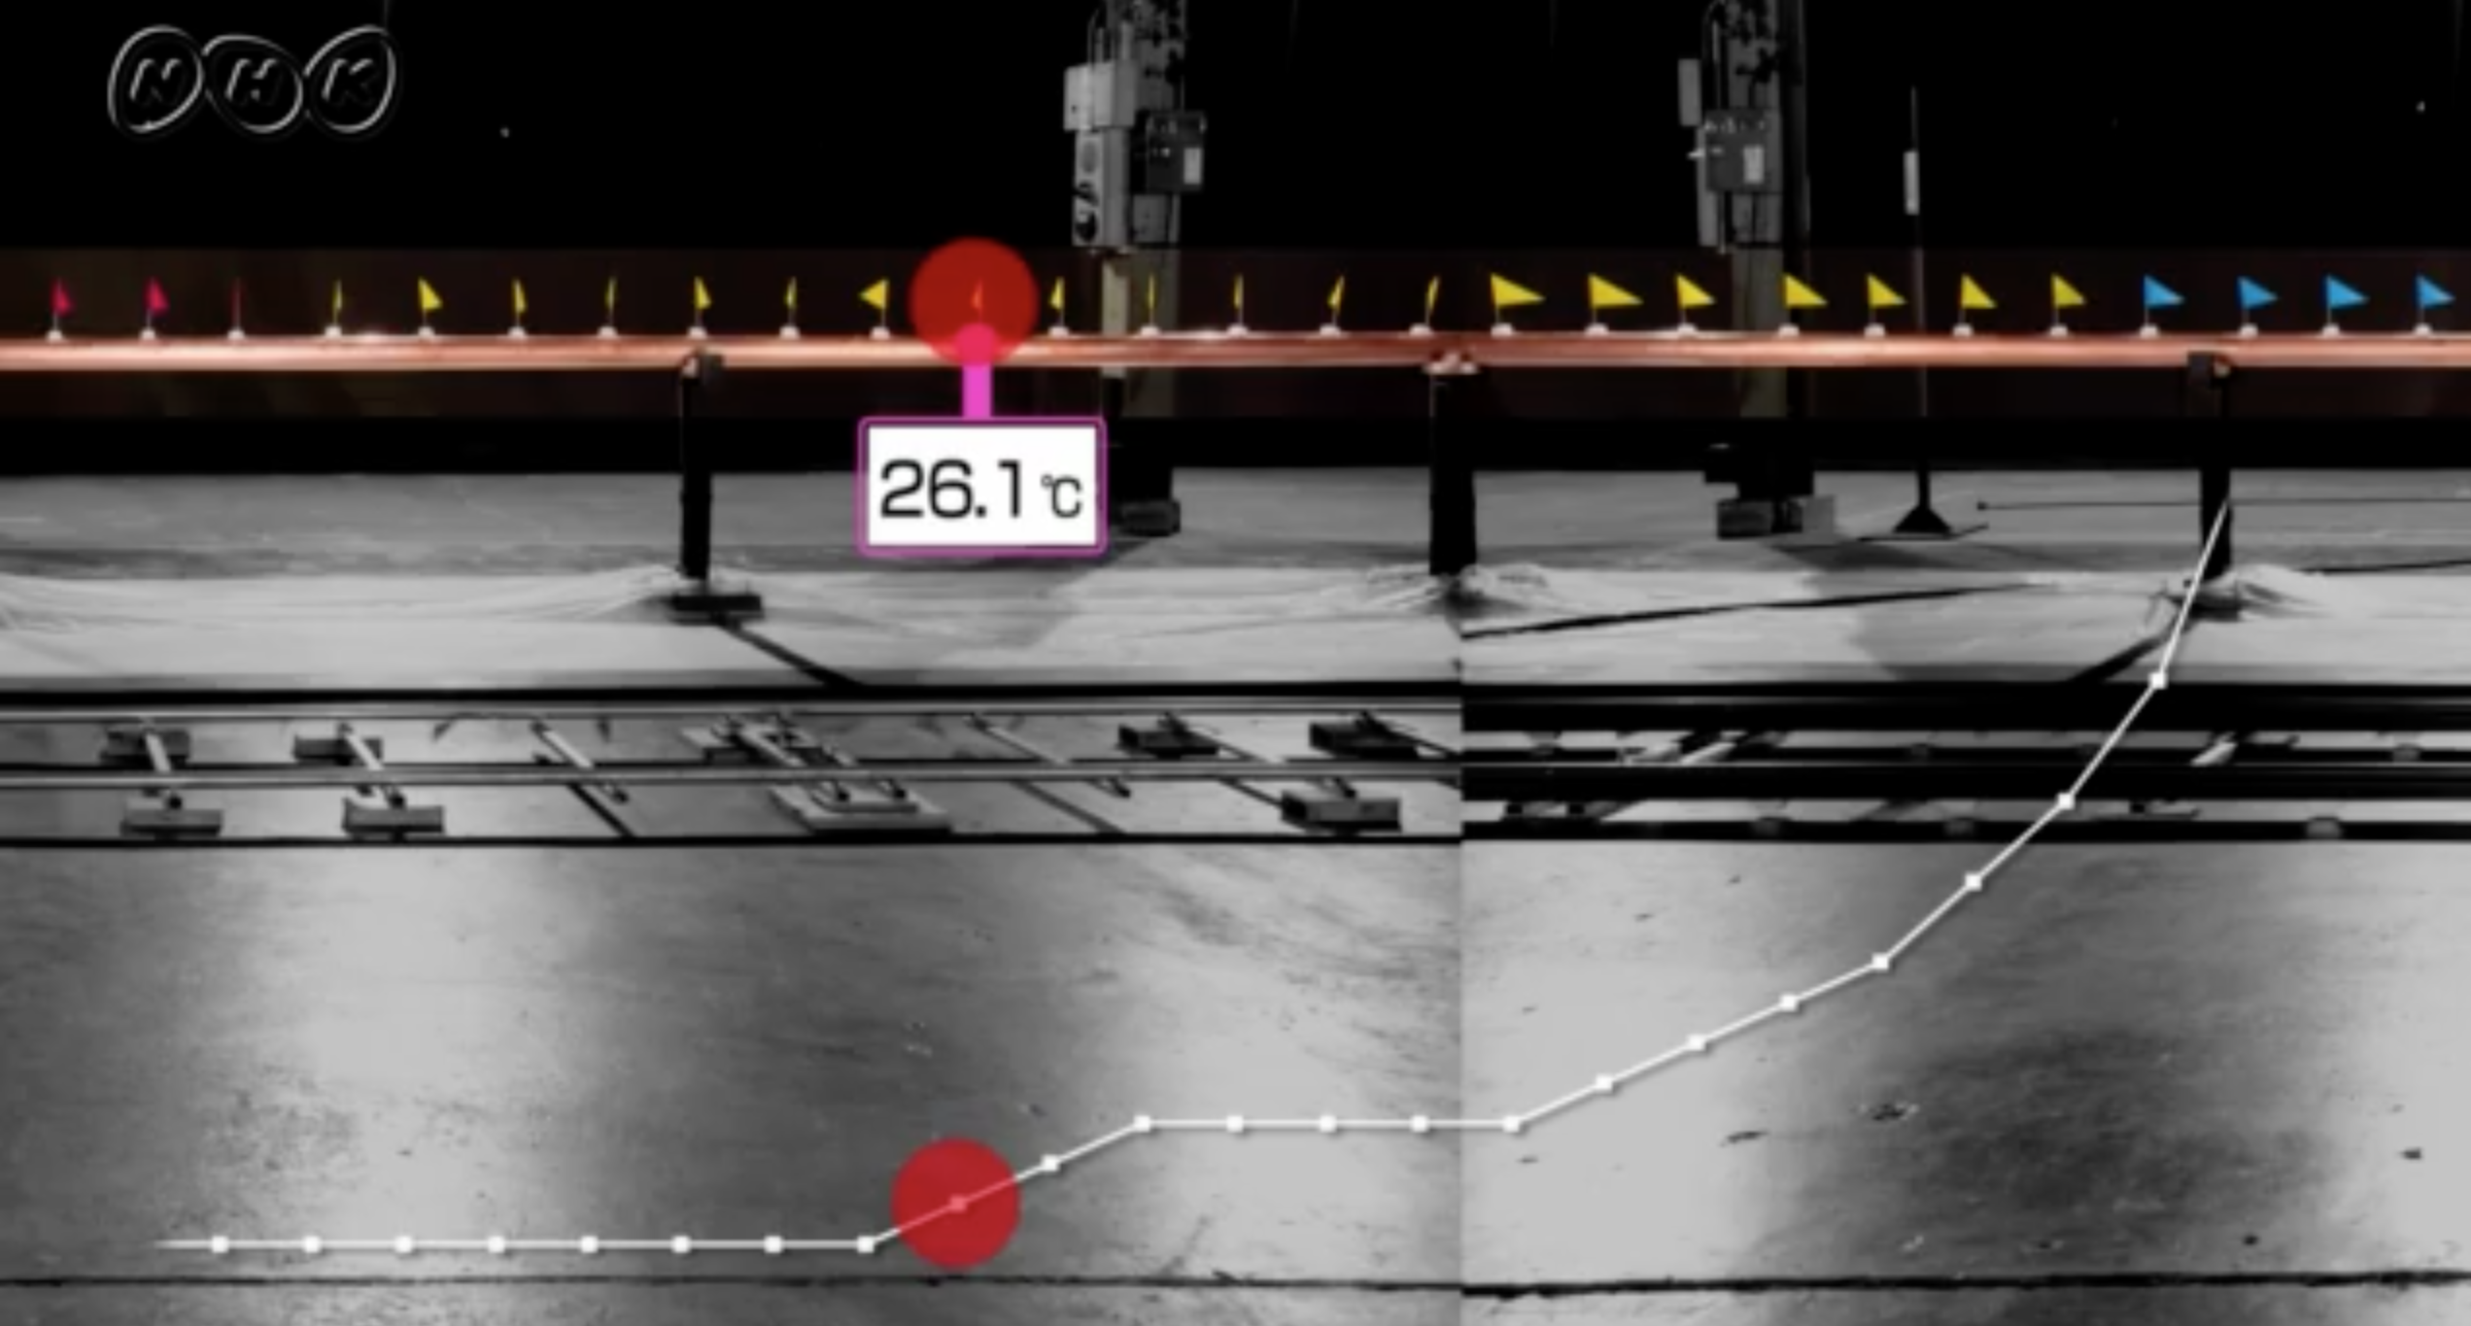
Length: 20m
Radius: 0.1m
TH~1273K
h~2.0 W/m2
~11.1m
Cited from: https://www2.nhk.or.jp/school/movie/bangumi.cgi?das_id=D0005110353_00000

